Slide 1
Employee Performance Analysis Using Excel
STUDENT NAME : Maheshwari O
REGISTER NO : 312216111
DEPARTMENT : B.com (Accounting and Finance)
COLLEGE : S.S.S. Jain college for Women

Slide 2
Employee Performance Analysis Using Excel

Slide 3
AGENDA :
Problem Statement
Project Overview
End Users
Our Solution and Proposition
Dataset Description
Modelling Approach
Results and Discussion
Conclusion

Slide 4
PROBLEM STATEMENT :
Performance evaluations provide a stepping-stone for the employee and supervisor to identify and discuss areas where performance can be improved. It can also be an important opportunity for employee and manager expectations to be reinforced or clarified.

Slide 5
PROJECT OVERVIEW :
The main objective of Employee Performance Analysis is to create an analysis model that makes performance management at individual employee level simpler. Employee performance analysis involves evaluating various metrics such as productivity, efficiency, and output quality to assess individual and team performance. By leveraging data analytics, organizations can identify top performers, areas for improvement, and potential training needs.

Slide 6
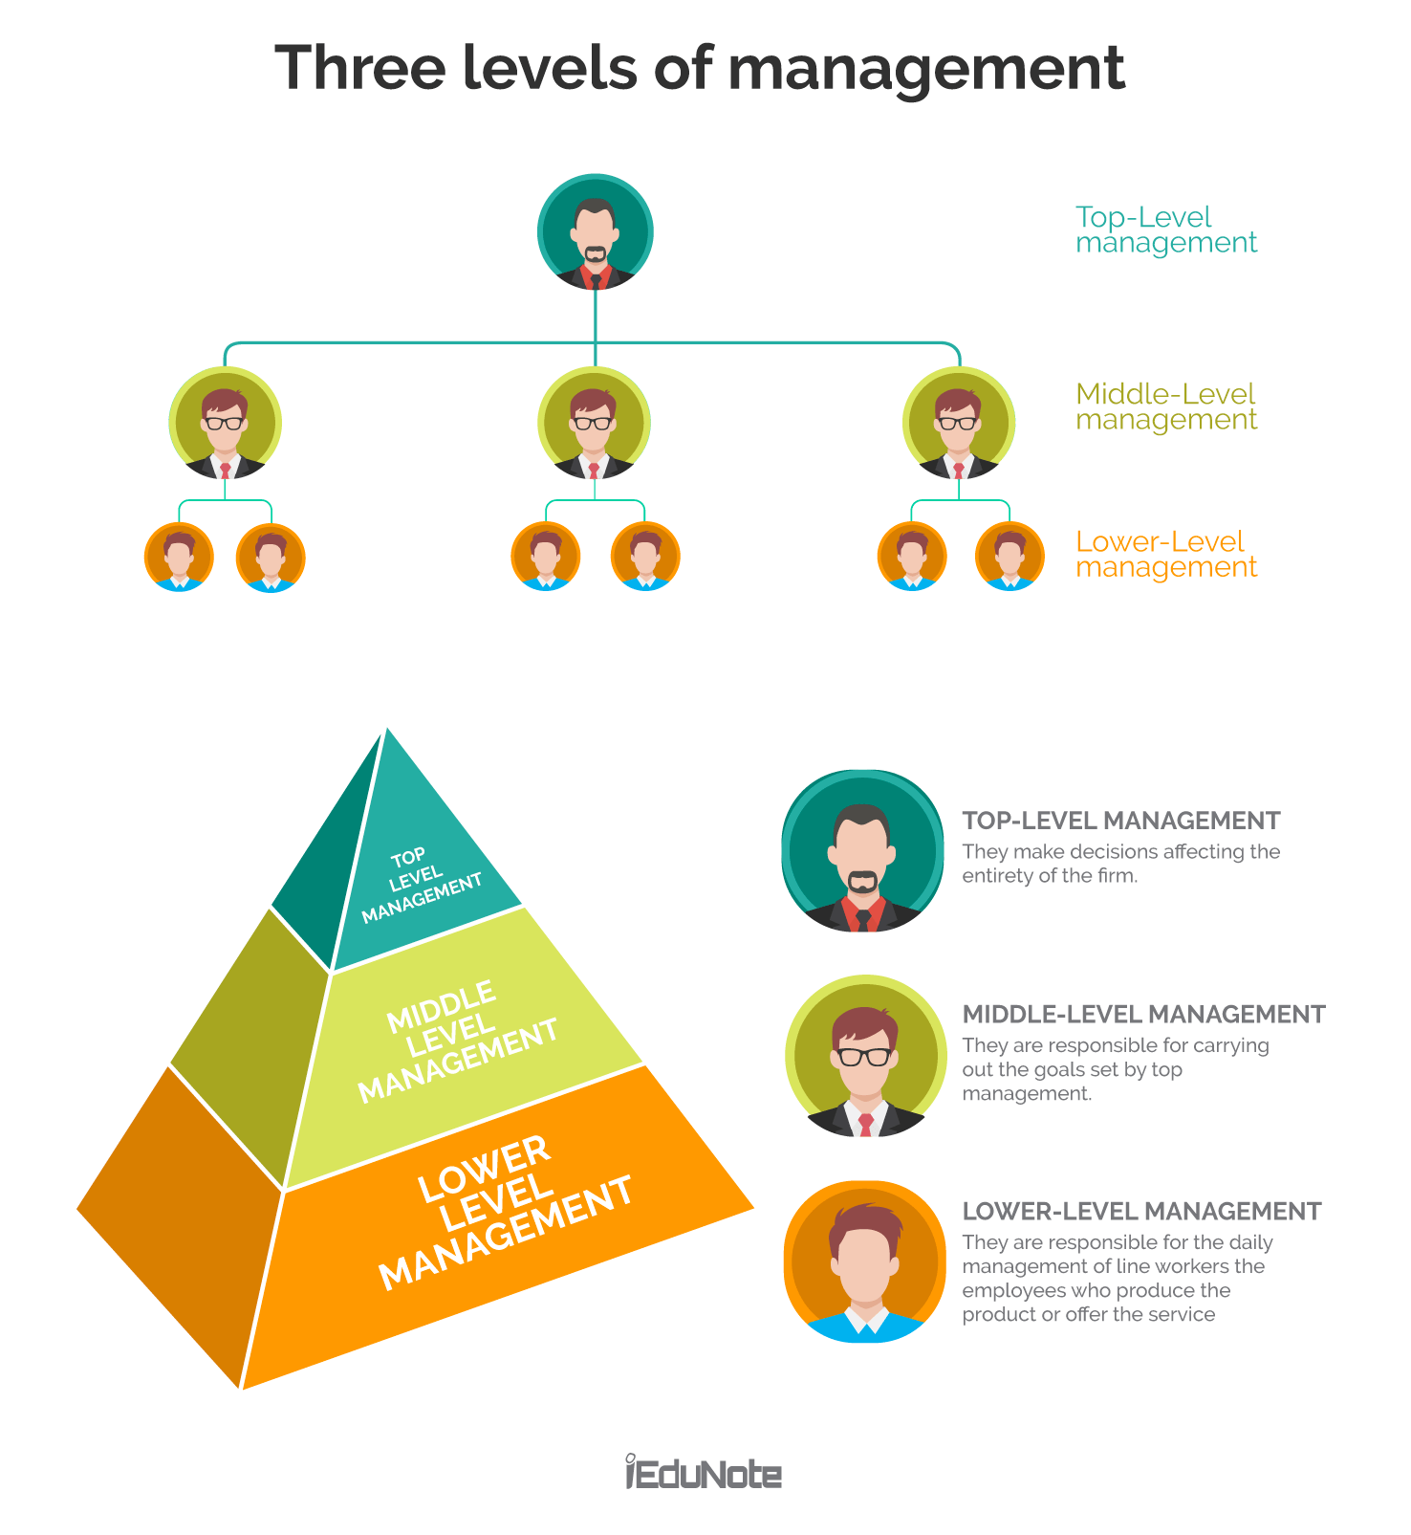
WHO ARE THE END USERS ?

Slide 7
OUR SOLUTION AND ITS VALUE PROPOSITION :
Conditional Formatting- Missing
Filter-Sort
Formula-Performance
Pivot-Summary
Graph- Data visualization

Slide 8
THE "WOW" IN OUR SOLUTION
Performance Level =IFS(Z8>=5,"VERY HIGH",Z8>=4,"HIGH",Z8>=3,"MED",TRUE,"LOW")

Slide 9
MODELING :
Data Collection
Data fetched from Edunet portal for set of employee
Feature Collection
Segregating features of employee data from the whole dataset
Data Cleaning
Filtering out original values required by removing the blank data in the sheet
Performance Level
Performance level is measured by using the employee rating given for every individual

Slide 10
MODELING :
Summarisation
Summarising the dataset by using Pivot table.
Visualisation
Visualised the dataset using charts.

Slide 11
RESULT :

Slide 12
RESULT :

Slide 13
CONCLUSION :
Employee Performance has been implemented to cater the needs of company employees and administrative people of the company in submitting appraisals, evaluating the appraisals, calculating the average ratings of the employees and finally generating the consolidated ranks effectively with role based access. The resultant data will be used by our model to analyze and predict the performance levels of new individuals thus making the recruitment process simpler. The final result of the analyzed data is that 51% of the employees are rated as “Medium”, 25% as “Low”, 14% as “High”, 9% as “ Very High”.

